Slide 1
User Experiences
Session 08

Slide 2
Outline Material
UX Definition
Design Process
Managing Complexity
Interaction Models
Camera Models
Visual & Audio Elements
Input Devices
Navigation Mechanisms
Accessibility Issues
Allowing for Customization

Slide 3
Introduction to UI
User interface is often called the presentation layer
The experience must be entertaining
Outputs = Visual + audio elements
Inputs = Control elements

Slide 4
Introduction to UI
Interactive Element
The interactive part of the user experience is concerned with the way the player interacts with the game.
Visual Element
The visual element concern the overall impact of the artwork and how it meshes and combines to present an overall consistent picture of the player.
Audio Element
Many games are unplayable without audio element. This clearly indicates the importance of sound.

Slide 5
Design process
Define the gameplay modes.
Choose a screen layout
Tell the player what he needs to know
Let the player do what she wants to do
Shell menus

Slide 6
Design process
Define the gameplay modes.
Camera model, interaction model, and gameplay (challenges and actions)
Define the primary gameplay mode first, then move on to others.
Think about the visual elements and controls that will be needed for each mode.
Define a different user interface for each gameplay mode.

Slide 7
Design process
Choose a screen layout
Main view will be the largest visual element on the screen
Find a balance between the amount of screen space devoted to the main view and amount for feedback elements and onscreen controls
Tell the player what he needs to know
Select data from core mechanics that you want to show
Choose feedback elements to display that data
After defining critical information, move on to optional information
Keep in mind the general principles of good interface design

Slide 8
Design process
Let the player do what she wants to do
Begin devising appropriate control mechanism for each action the player can take that affects the game
Create visual and audible feedback for actions
Map input devices to player’s actions based on chosen interaction model
Each time you move to new gameplay mode, note actions it has in common with other modes to keep control mechanisms consistent

Slide 9
Design process
Shell menus
Shell menus allow the player to start, configure, and manage operation of game before and after play
Player should not have to spend too much time in shell menus
Shell interface is the first thing players see, so don’t skimp on design

Slide 10
Interaction models
Avatar-based
Player acts through a character
Multi-present
Player acts on many places at once
Party-based
Player controls a group of people
Contestant
Player acts as if on a TV game show
Desktop
Similar to computer desktop metaphor
Common types
Means by which the player projects his intentions into the game world

Slide 11
Camera models
Determine virtual camera behavior by asking how you want player to view the world
What the camera focuses on
How the camera behaves
Perspectives are camera models that are largely fixed and unintelligent.
Virtually all standalone games running on powerful game hardware employ 3D
Use 3D graphics only if you can do it well
Good 2D is preferable to bad 3D

Slide 12
Camera models
First-person perspective
Used only in avatar-based gameplay modes
Third-person perspective
Used for avatar-based games and allows the player to see the avatar
Most common perspective in 3D action and action-adventure games

Slide 13
Camera models
Aerial perspectives
Used with party-based or multi-present interaction models
Types of aerial perspectives:
Top-down perspective—used to display maps
Isometric perspective—camera angle is such that all three dimensions can be seen at once
Camera tilted down about 30 degrees from horizontal
Free-roaming camera—camera controlled by player
Context-sensitive camera model—camera moves intelligently to follow the action

Slide 14
Visual Elements
Feedback elements communicate details about the game’s inner states
Indicators inform about the status of a resource
Digits, needle gauge, power bar, small multiples, colored lights, icons, text are common types of indicators
Mini-maps show an area larger than the main view so player can orient herself
Colors give additional clues

Slide 15
Visual Elements
Character portraits
Can give the player a better idea of the person
Can function as a feedback element if they change
Key issues regarding text in a game
To make localization easier, store text in text files
Choose typefaces and formatting carefully to harmonize with theme and present information clearly

Slide 16
Audio Elements
Sound effects
Vibration
Ambient sounds
Music
Dialog and voiceover narration

Slide 17
Input devices
Three-dimensional input devices
Accelerometers (e.g. Wii controllers), GPS receivers
Two-dimensional input devices
Directional pads
Joysticks
Mouse or trackball
Touchpad and touch screen
One-dimensional input devices
Controller buttons and keys
Knobs, sliders, and pressure-sensitive buttons

Slide 18
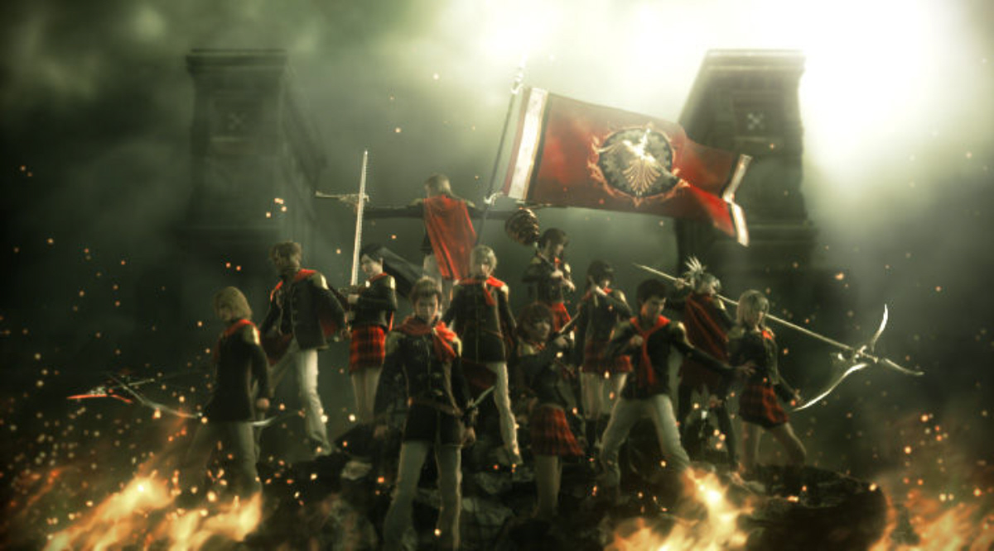

Case Study
Make a group of six and discuss about the game UI possibility of following game:

